Slide 1
Sports Popularity Time Series Analysis
FRE 6351 Econometrics and Time Series Analysis
PRESENTED BY Qiwei Mo, Zebei Wang, Yixin Xu
05/9/2024

Slide 2
Outline
Time Series Data Analysis
Data Stationary Check
Constructing forecasting models
Improvement made based on the forecasting results

Slide 3


Introduction
Sports League Overview: Examines NBA's global appeal, NFL's cultural significance, and MLB's historical depth.
Forecasting Popularity: Uses Google Trends and statistical models to predict seasonal trends in sports popularity.

Slide 4
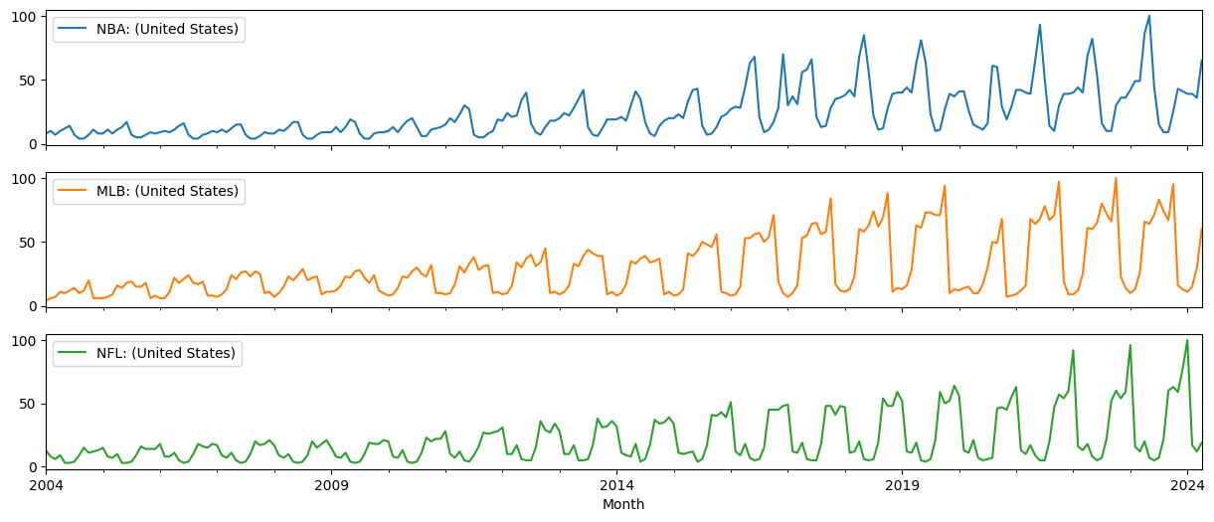
Original Data Visualization

Slide 5
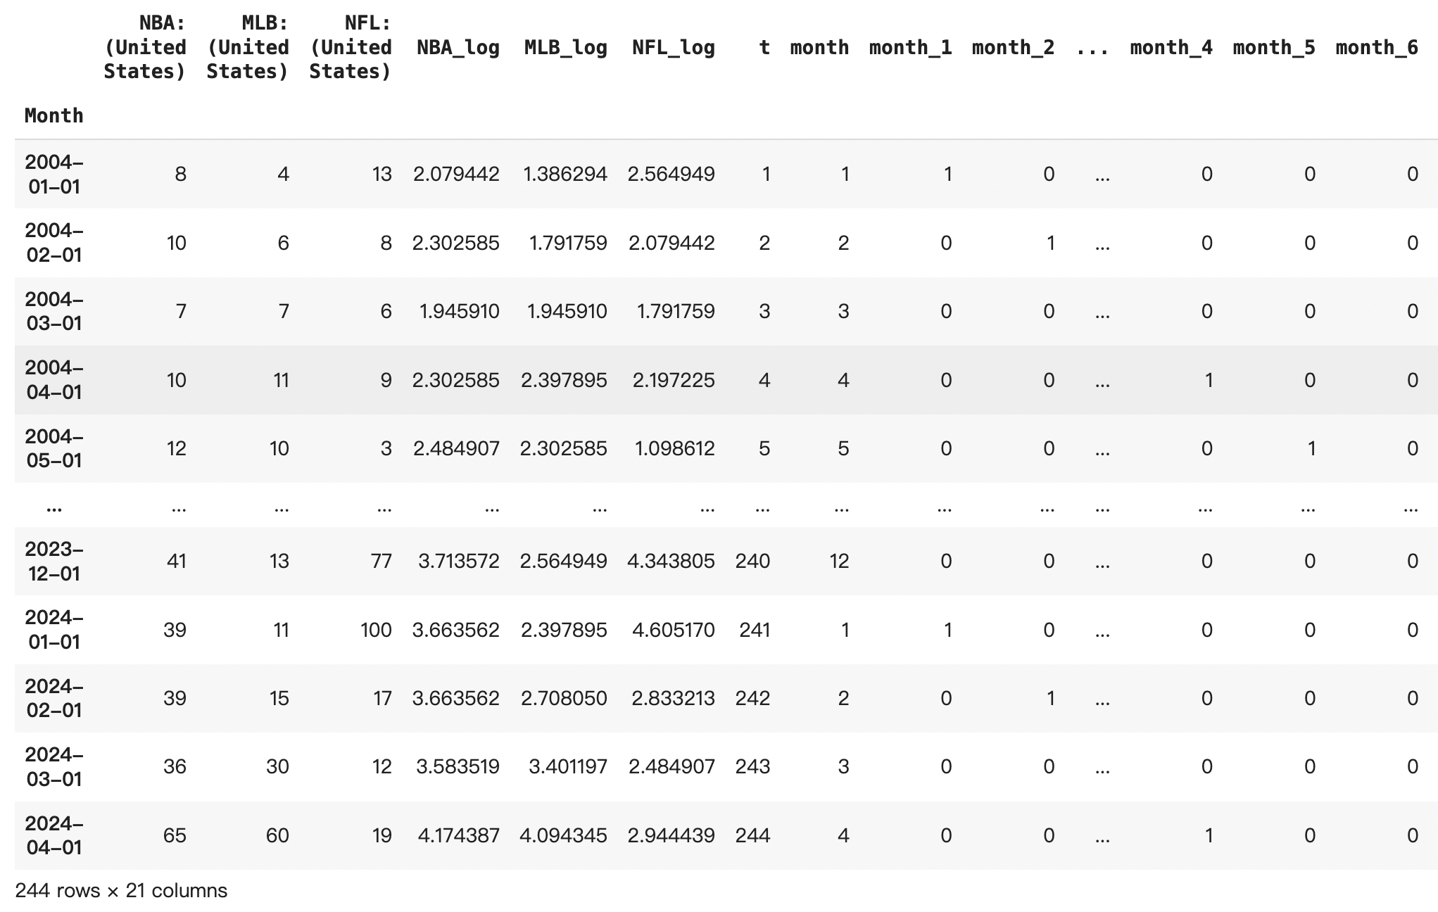
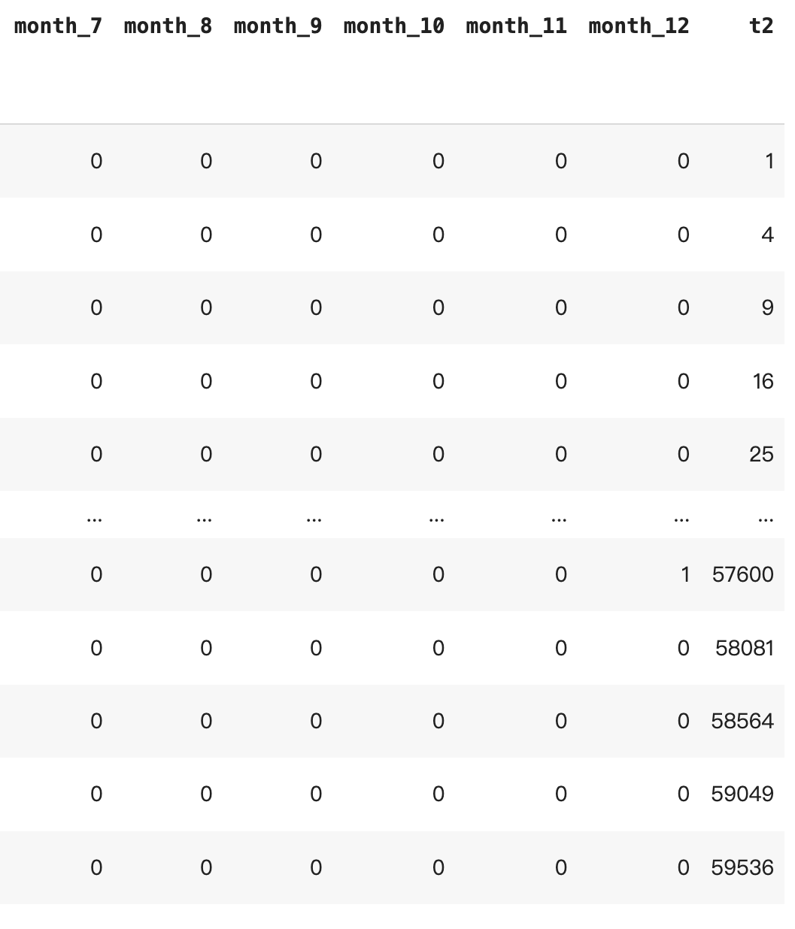
Data Preprocessing

Slide 6
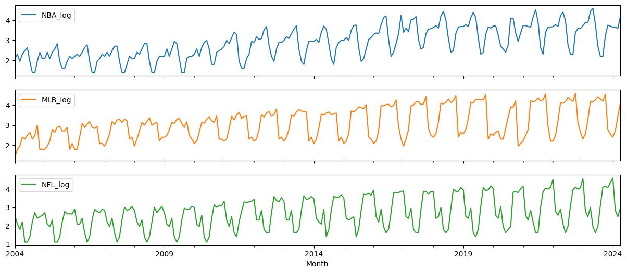
Log Data Visualization

Slide 7
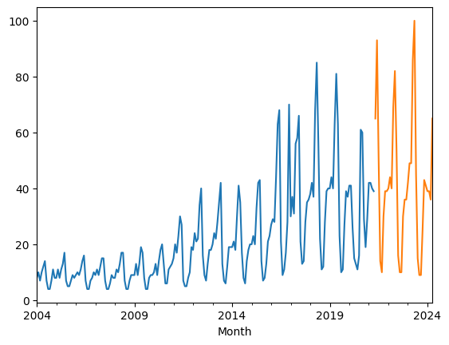
Train Test Split
df_train = df[0:208]
df_test = df[208:]
First 17 years to be train set
Last 3 years to be test set
Adjusted train: Use the previous 2 years data’s mean to cover the covid year data

Slide 8
Stationary Check
Decomposition
Exponential Smoothing
Differencing

Slide 9
Decomposition
Model: Yt = Tt × St × εt
Trend: The overall direction or long-term increase or decrease in the data, illustrating how the series evolves over time.
Seasonal: Regular variations that repeat over a specific period, such as daily, monthly, or quarterly, indicating predictable patterns.
Residual: The random or unexplained variation left in the series after the trend, seasonal, and cyclical components are accounted for using additive decomposition.

Slide 10
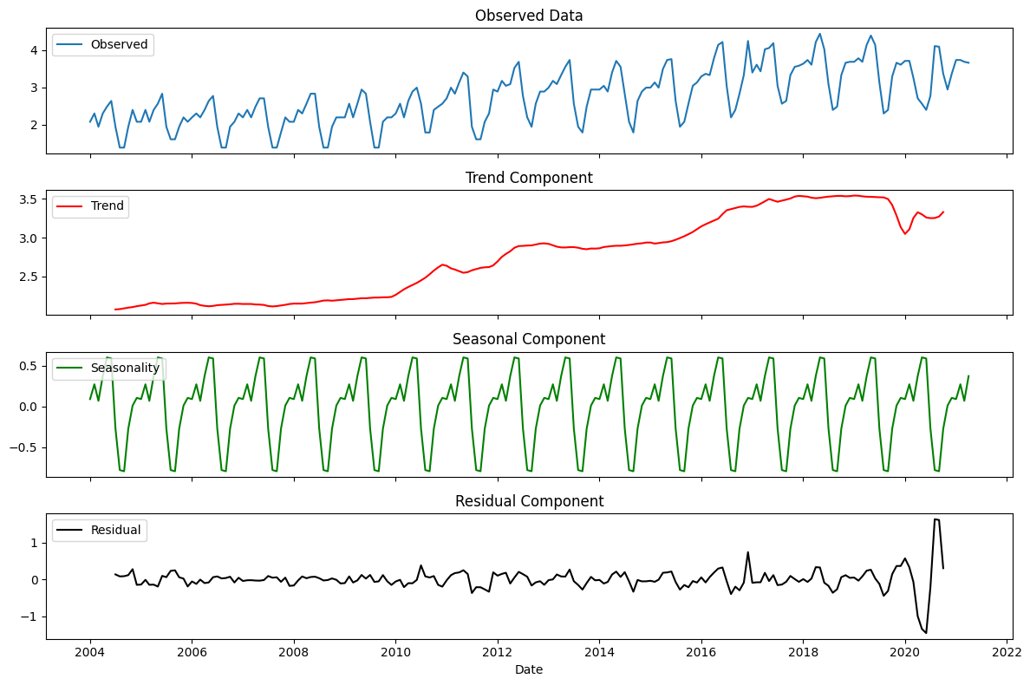
NBA Decomposition

Slide 11
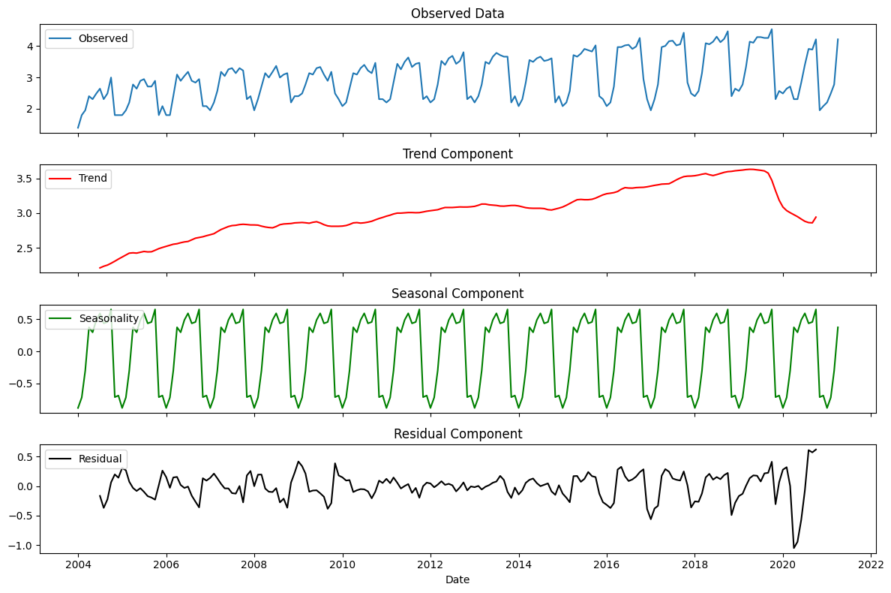
MLB Decomposition

Slide 12
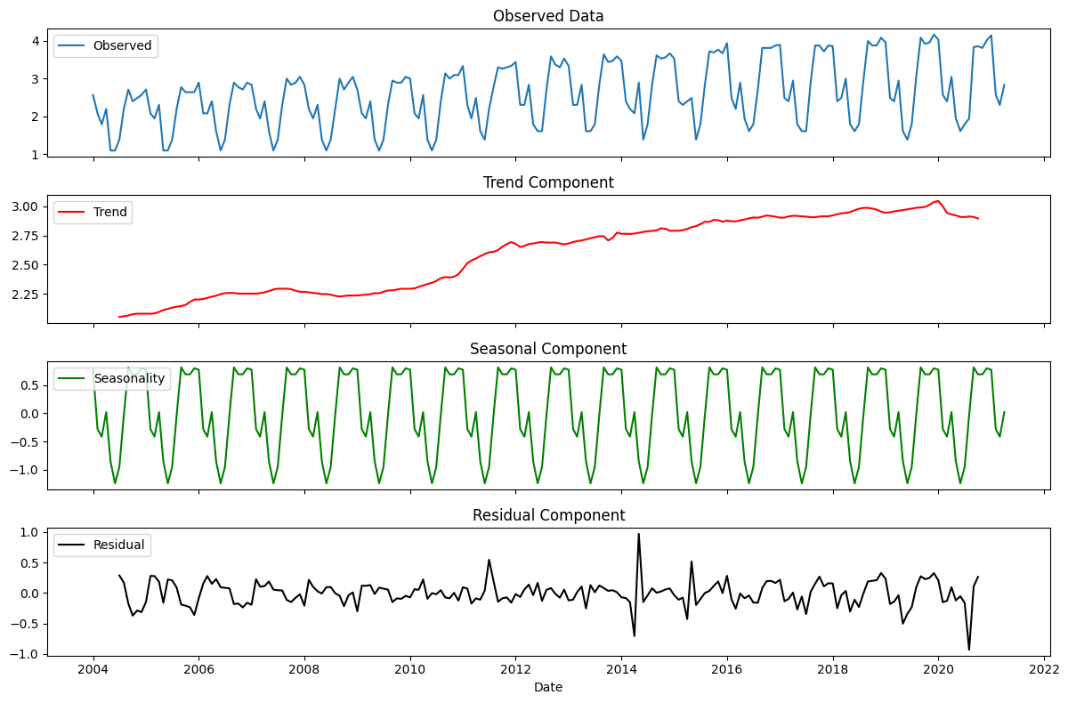
NFL Decomposition

Slide 13
Exponential Smoothing
Exponential Smoothing Overview: A time series forecasting method that applies exponentially decreasing weights to past observations, prioritizing recent data for more responsive forecasting.
Types of Exponential Smoothing: Includes simple smoothing for stable data, Holt’s method for trends, and Holt-Winters for handling both trends and seasonal variations.
Application and Flexibility: Widely used in fields like finance, economics, and supply chain management due to its simplicity, efficiency, and adaptability to different data patterns.

Slide 14
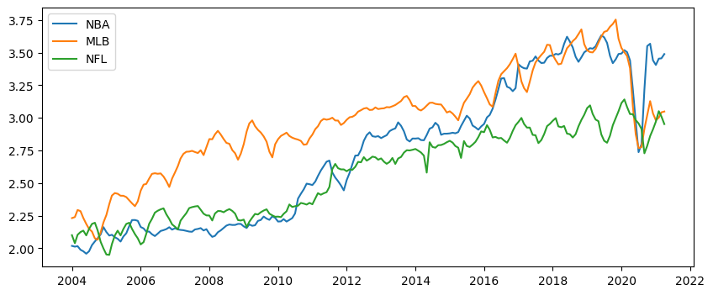
Exponential Smoothing

Slide 15
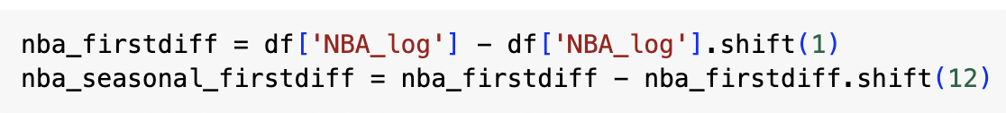
Differencing
Eliminates Trends: Differencing removes trends and seasonality, making the data stationary.
Improves Model Fit: It stabilizes variance, enhancing the accuracy of forecasting models.
Enables Testing: Facilitates stationarity testing, ADF, essential for reliable time series analysis.

Slide 16
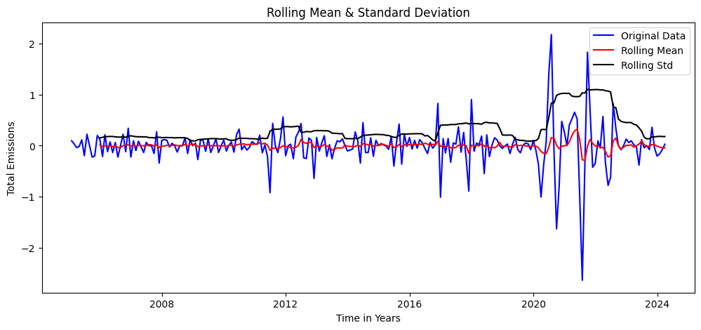
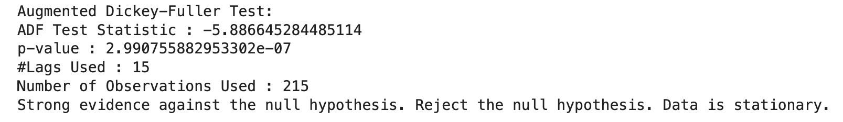
Differencing for NBA

Slide 17
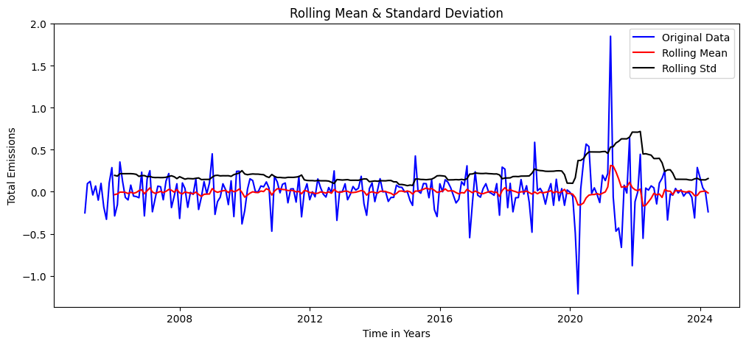
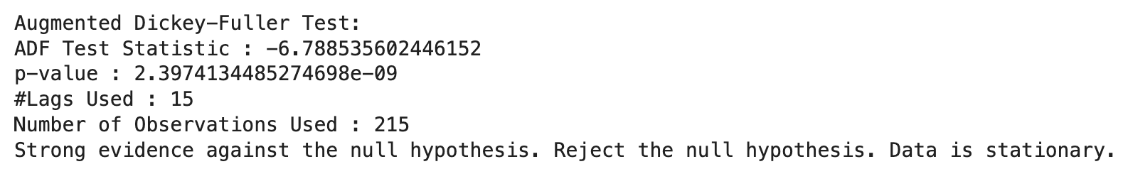
Differencing for MLB

Slide 18
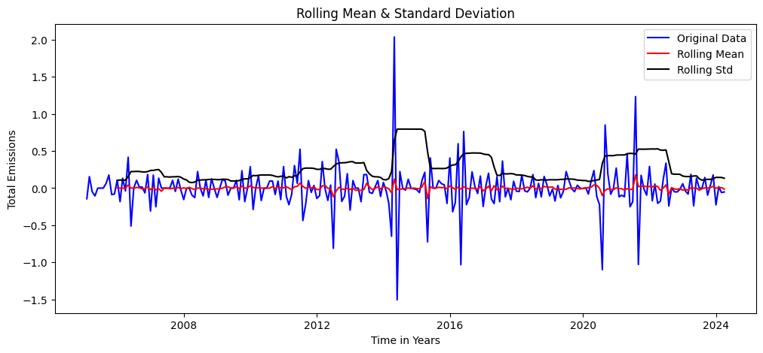
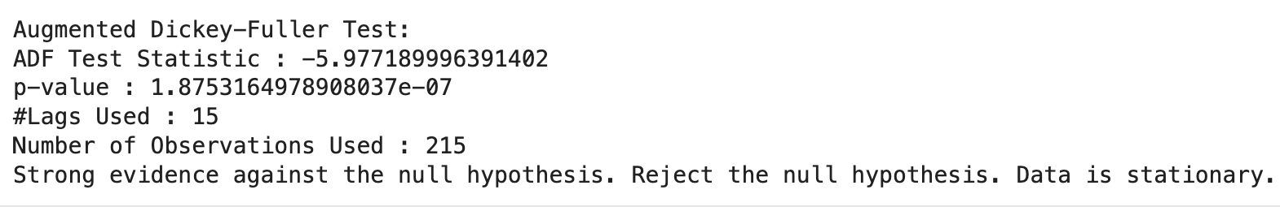
Differencing for NFL

Slide 19
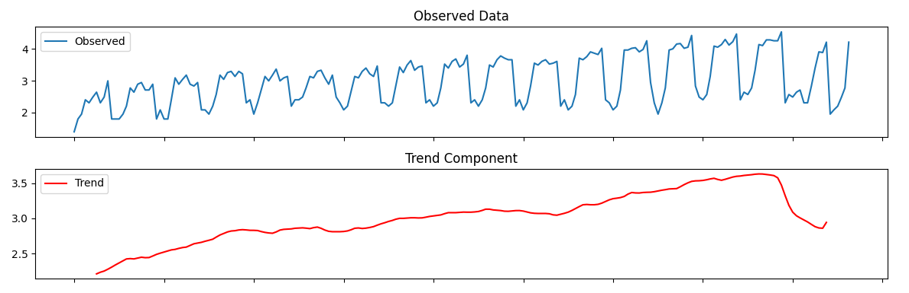
Construct Forecast Model
Model: Yt = Tt × St × εt
Trend:
Experimented with simple Linear Regression, Polynomial Regression, Moving Average, Exponential Smoothing. E.g MLB
Seasonality:

Slide 20
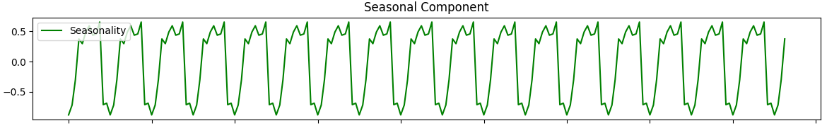
Construct Forecast Model
Seasonality:
Use multiplicative model since the seasonality effect changes.
Obtained seasonality using statsmodels model decompose method in python.

Slide 21
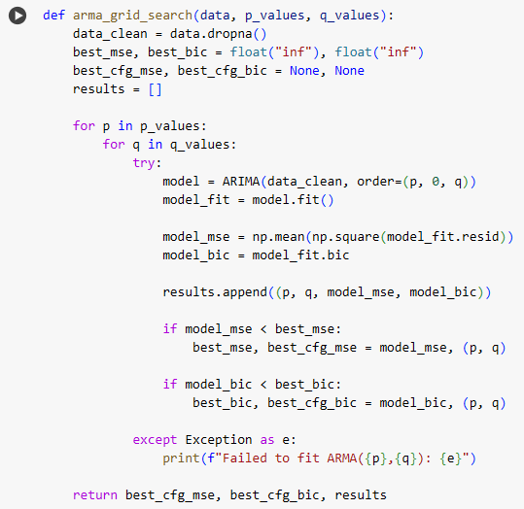
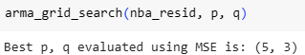
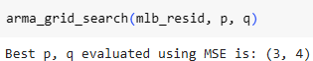
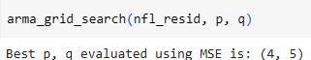
Construct Forecast Model
Residuals: Actual - T - S (stationary)
Model using ARMA(p,q) model.
Grid Search to find the best parameters for p and q using MSE as evaluation metric.
NBA
MLB
NFL

Slide 22
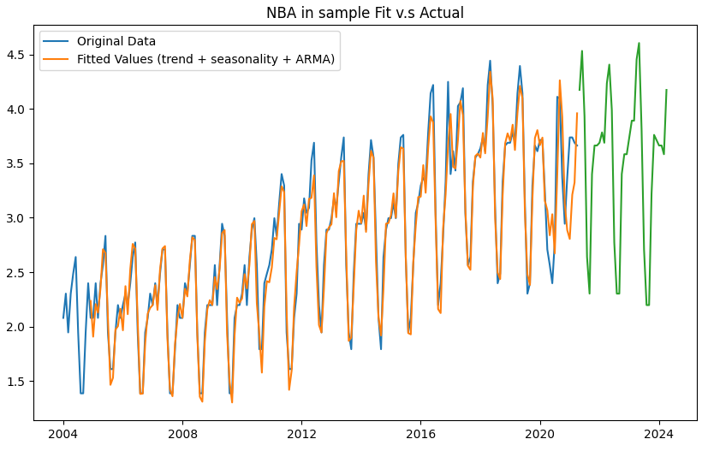
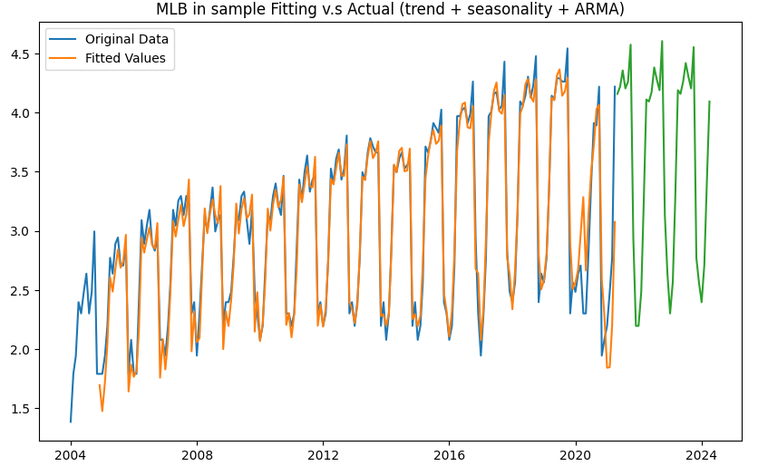
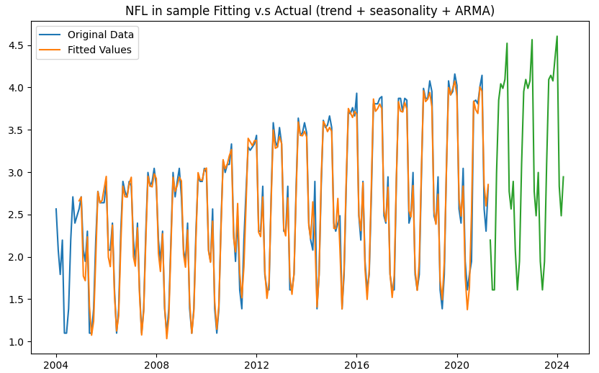
Forecasting Model: In-Sample Fit
NBA
MLB
NFL
RMSE: 0.1816
RMSE: 0.1901
RMSE: 0.1324

Slide 23
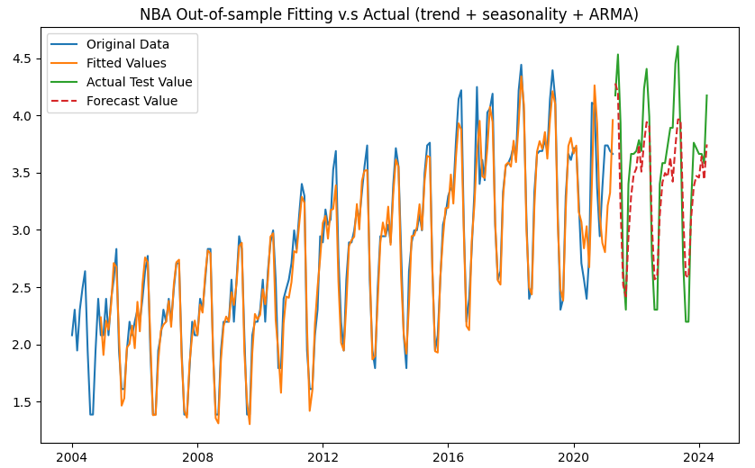
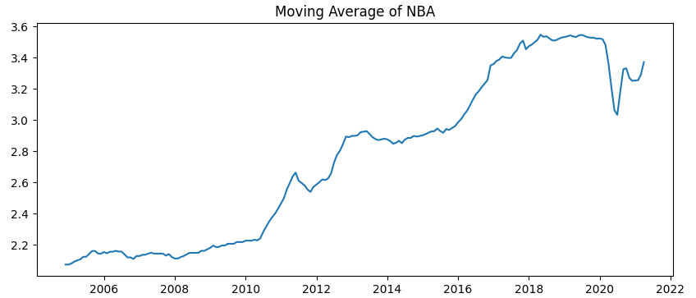
Forecasting Model: Out-of-Sample Fit
NBA:
Test RMSE: 0.3412
Moving Average:

Slide 24
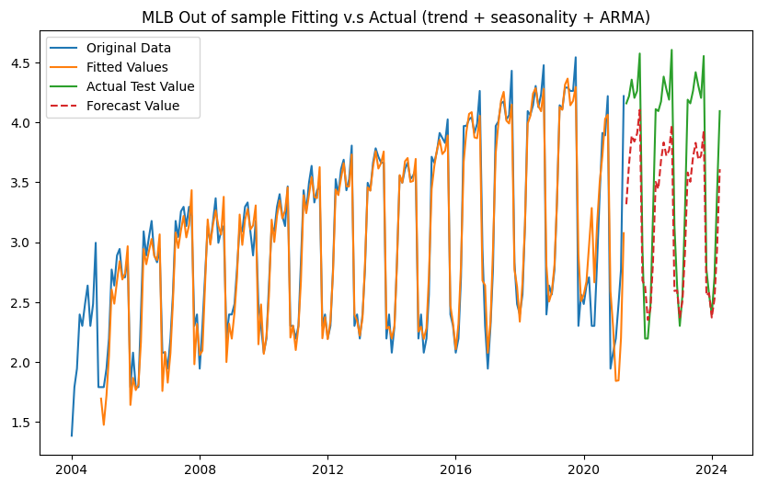
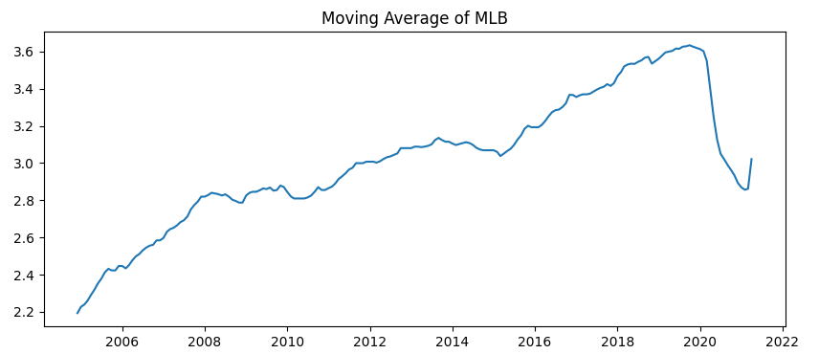
Forecasting Model: Out-of-Sample Fit
MLB:
Test RMSE: 0.4499
Moving Average:

Slide 25
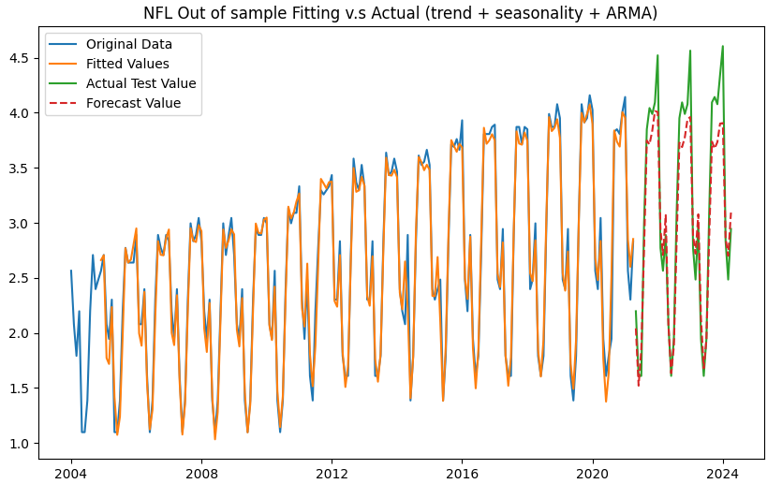
Forecasting Model: Out-of-Sample Fit
NFL:
Test RMSE: 0.3109
Moving average less affected by the Pandemic, so better RMSE score.

Slide 26

Improvement：
#1 Data adjustment
Now we try to replace the data from 2020 to 2021 with the average value of corresponding dates of 2018 and 2019.
For example: 2020-05-01 = [(2018-05-01) + (2019-05-01)] / 2

Slide 27
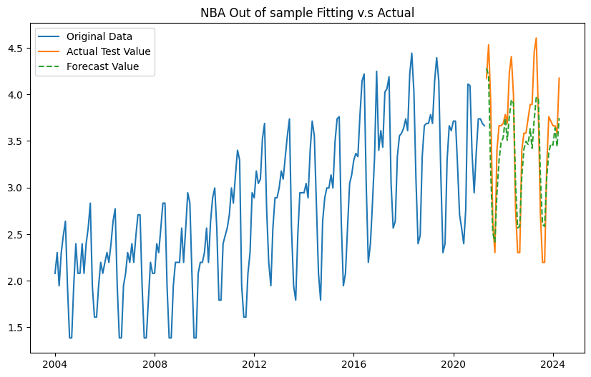
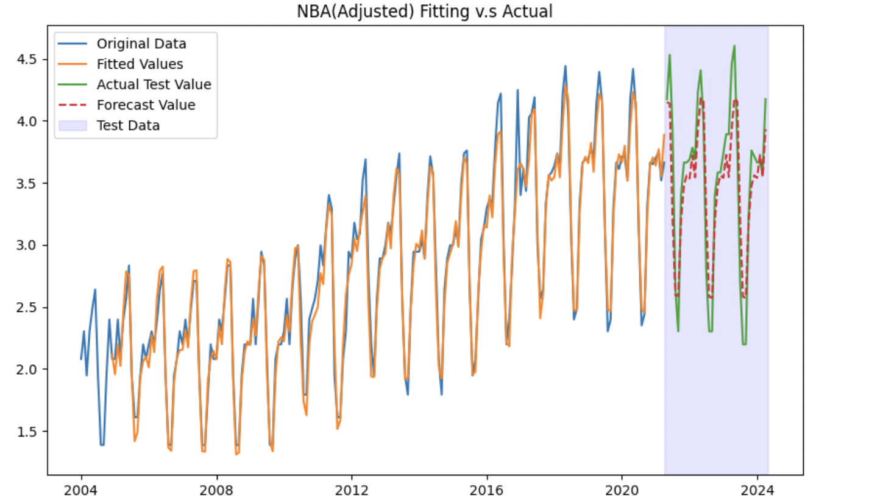
Improvement: Further Analysis on Fitting Trend
Original NBA Data
After Adjustment
NBA RMSE of Original data is: 0.3412
NBA RMSE after adjusting data is: 0.2865
16% Decrease

Slide 28
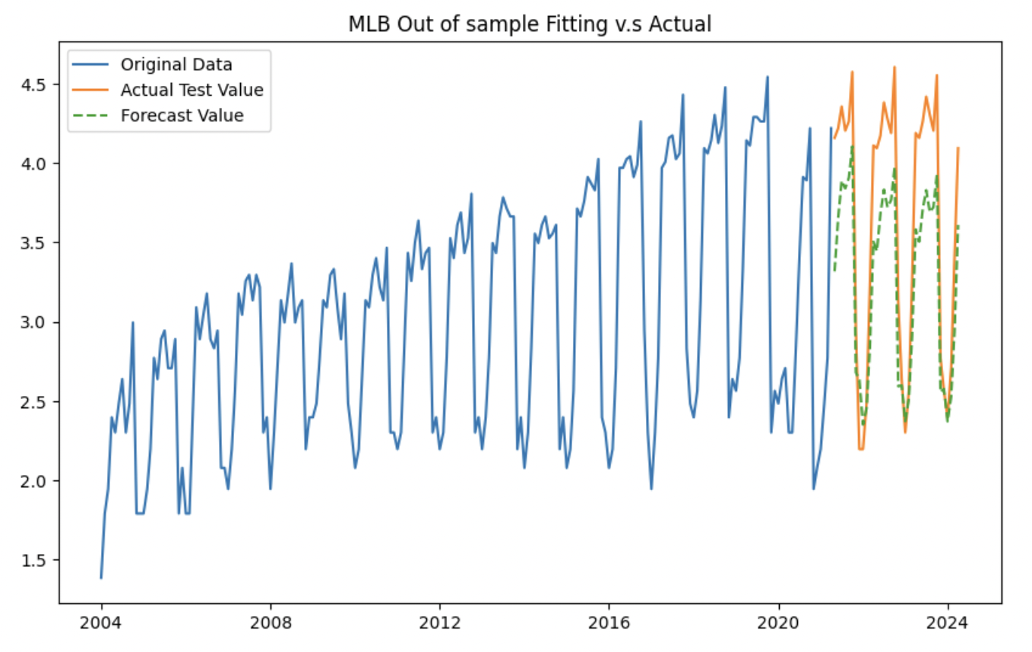
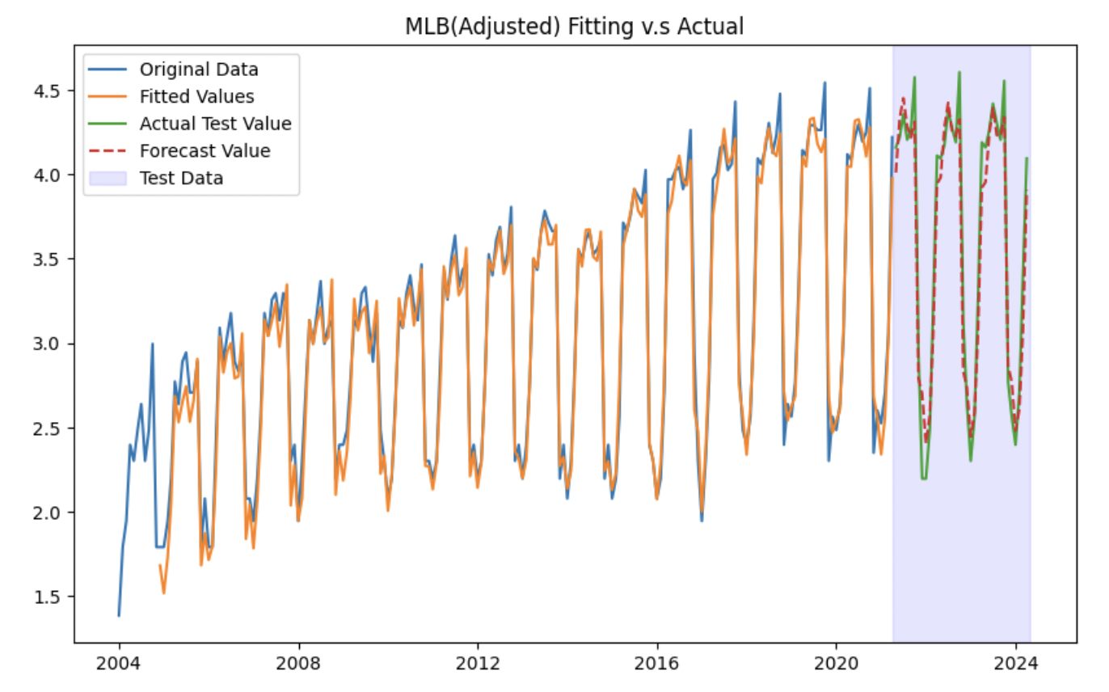
Original MLB Data
After Adjustment
MLB RMSE of Original data is: 0.4499
MLB RMSE after adjusting data is: 0.1793
60.15% Decrease

Slide 29
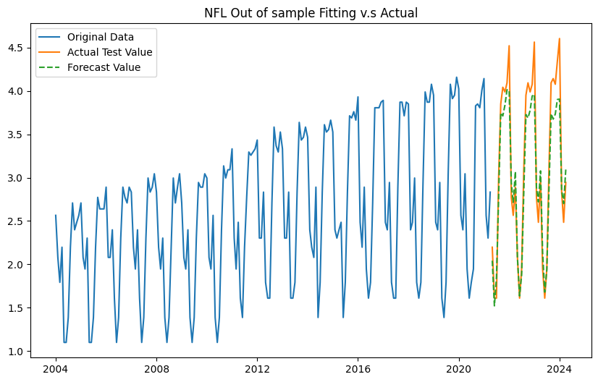
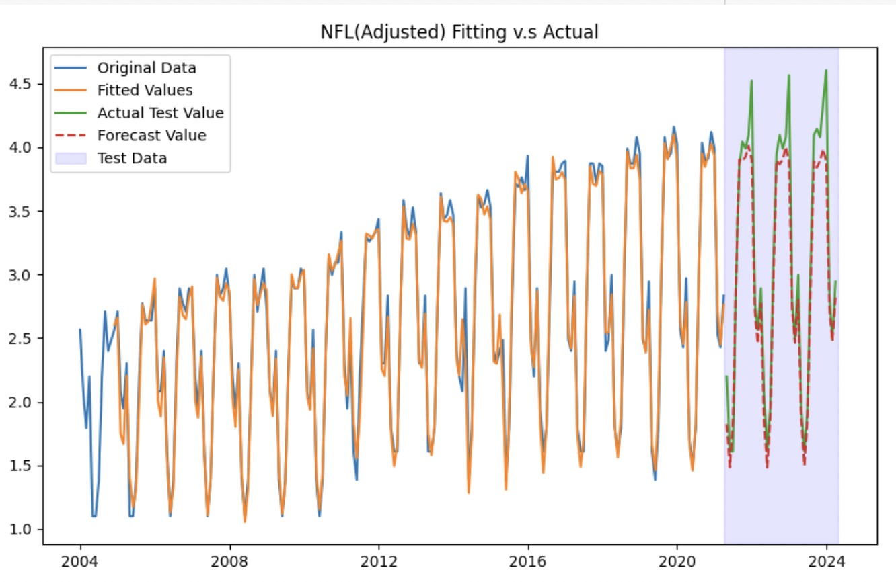
Original NFL Data
After Adjustment
NFL RMSE of Original data is: 0.3109
NFL RMSE after adjusting data is: 0.2473
20.46% Decrease

Slide 30
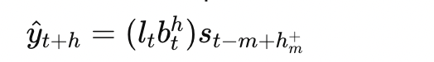
Improvement：
#2 Holt-Winters Multiplicative Model
The Holt-Winters Multiplicative Model is a type of exponential smoothing model
It is particularly effective for time series data with seasonal variations that change proportionally over time.
This model is suitable for forecasting when data exhibits both trend and seasonal components.

Slide 31
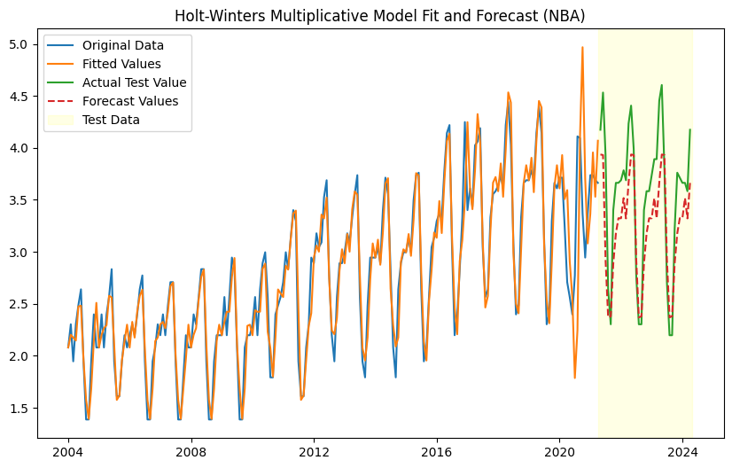
Improvement: Further Analysis on Fitting Trend
Best Model Fit
After Adjustment
NBA RMSE after adjusting data is: 0.2865
NBA RMSE using HWMM is: 0.4235
47.82% increase

Slide 32
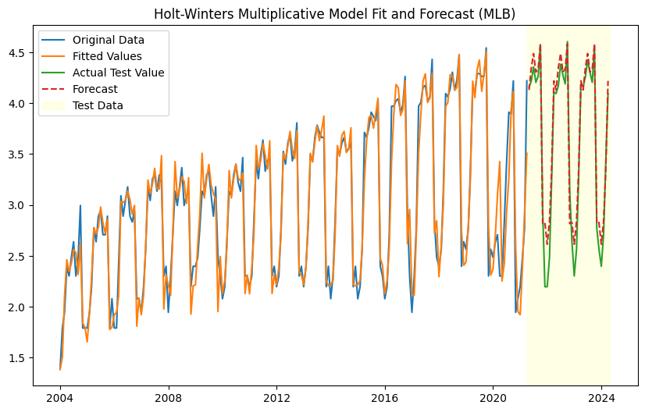
Best Model Fit
After Adjustment
MLB RMSE after adjusting data is: 0.1793
MLB RMSE using HWMM is: 0.1945
8.42% increase

Slide 33
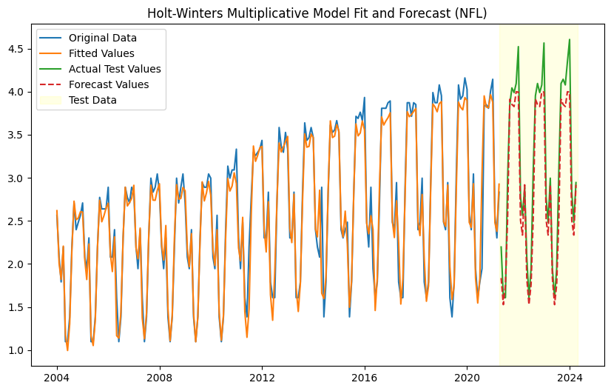
Best Model Fit
After Adjustment
NFL RMSE after adjusting data is: 0.2473
NFL: RMSE using HWMM is: 0.2851
15.29% increase

Slide 34
Improvement：
#3 Seasonal ARIMA
The Seasonal Autoregressive Integrated Moving Average (SARIMA) model is widely used for data with non-stationarity, trend, and seasonal patterns.
It extends the capabilities of the ARIMA (Autoregressive Integrated Moving Average) model to handle the seasonality more explicitly.

Slide 35
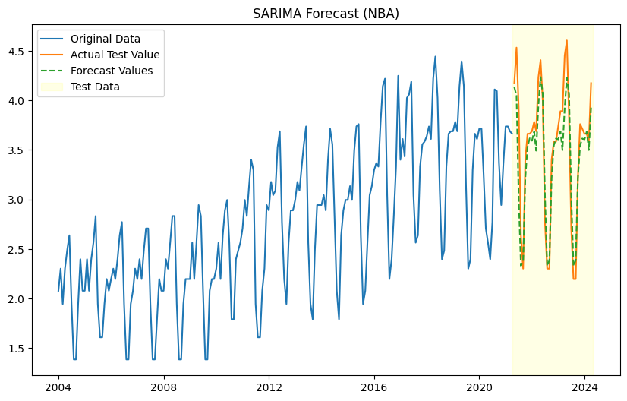
Improvement: Further Analysis on Fitting Trend
Best Model Fit
After Adjustment
NBA RMSE after adjusting data is: 0.2865
NBA RMSE using SARI is: 0.2636
7.99% decrease

Slide 36
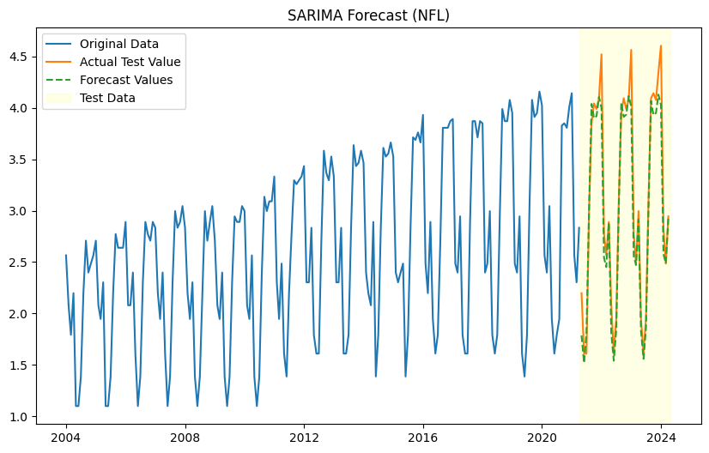
Best Model Fit
After Adjustment
NFL RMSE after adjusting data is: 0.2473
NFL RMSE using SARI is: 0.2139
13.51% decrease

Slide 37
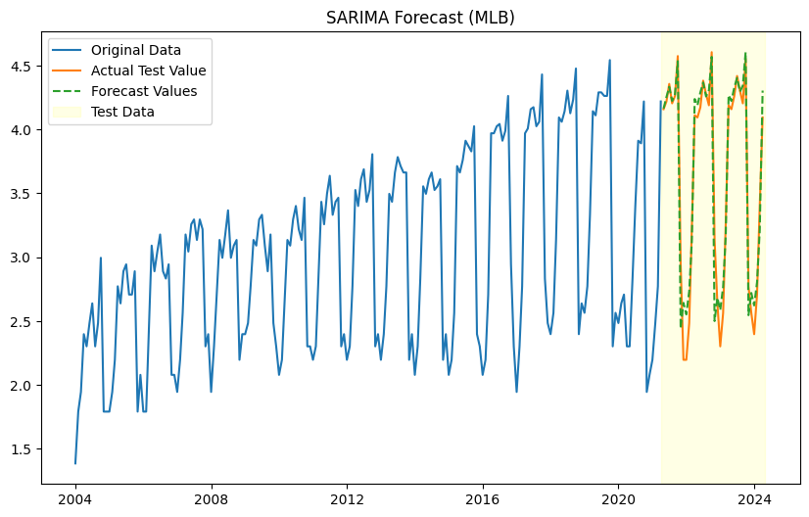
Best Model Fit
After Adjustment
MLB RMSE after adjusting data is: 0.1793
MLB RMSE using SARI is: 0.2039
13.72% increase

Slide 38
Conclusion
- Sports Popularity Data has clear trend and seasonality.
- Seasonality trend fits to the timing of major leagues.
- After data adjustment, and compared with The Holt-Winters Multiplicative Model, SARIMA performs the best based on RMSE scores.

Slide 39
Thank you !!!

